Slide 1
Data Management Assignment One Ethical Data Concerns with Anti-Money Laundering Systems
Ciaran Finnegan – TU060
Std No: d21124026

Slide 2
What is Anti-Money Laundering (AML)?
Anti-Money Laundering (AML) systems are typically an integrated set of processes and automated system to detect, prevent, and report restricted* activity in a financial network. Focus is on name screening and transaction monitoring .
Thus, a major characteristic of AML systems is the use of various internal and external WATCH LISTS. These are data stores that identify specific individuals or companies and are used to influence decisions made by financial institutions.
*’Restricted’ can be considered not just suspected criminal or terrorist related transactions, but also activity by ‘Politically Exposed Persons’ (P.E.P) who may be the subject of multi-government sanctions.
Notes:
Explain AML and WLM – key focus on data management issues of Watch Lists in commercial settings.
Emphasise definition of ‘restricted’

Slide 3
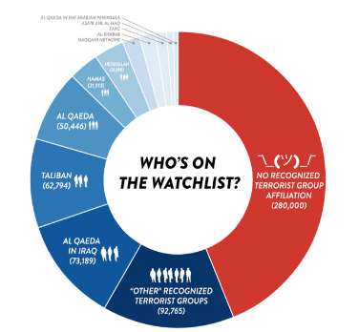
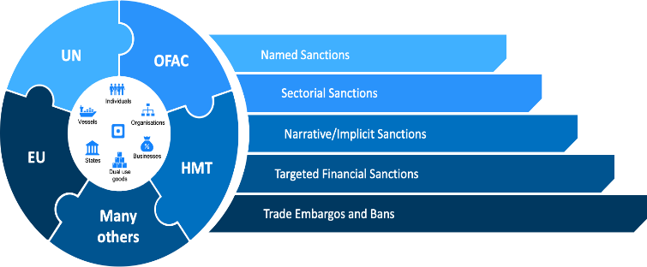

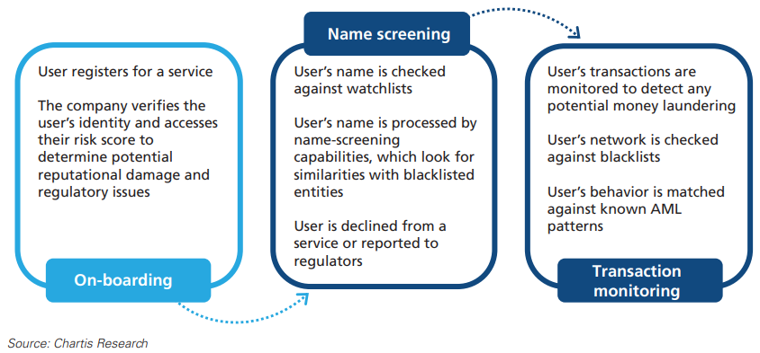
The AML (Name Screening) Process
Watch List Management (WLM) systems draw in data elements from published watch lists to identify potentially criminal actors using the services of a Financial Institution (FI).
^{[1]}
If data is poorly analysed, then an innocent customer may be denied a service or criminal activity could be left undetected.
Notes:
In this PPT, the initial focus is on the general data management challenges with Watch Lists, and then focus on one particular product operating in this domain.
The process flow boxes show a simplified view of the name screening and transaction monitoring process.
Introduce high level Watch List types
Commercial sources, including banks and Central Banks
Terrorist/criminal watch lists compiled by law enforcement
Sanction lists compiled by governments
Emphasise line at end about false positive v false negative. This is a theme we will return to again in the slide deck.

Slide 4


WLM Name Screening Challenge
^{[2]}
GDPR legislation recognises the right of individuals to be recorded in data stores with recognised titles and/or ethnic name spellings.
Notes:
Good example, as it covers a number of the challenges with name matching – which is more complex than it seems.
Border control example, but very relevant for commercial situations.
It is legitimate for any Irish person to transact business with their Irish name, even if it does not appear on their passport.
GDPR recognises the legitimacy of ethnic variations in names. Banks cannot insist on ‘Anglicising’ a person’s name in order to make transactions.
Just one example of how names can be hard to track in a FI system against a Watch List.

Slide 5

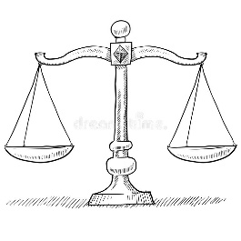
AML/WLM – Key Data Issues
Taking GDPR regulations as an example, the inclusion of an identified individual on a Watch List is, by definition, the recording of special category data.
However, the management of Watch List data is given special considerations because;
Authority granted by international law and controlled by several governmental (and non-governmental authorities). For example, Article 9 and 10 of EU GDPR legislation includes the basis for collection and processing personal data for AML purposes ^{[3]}. This compliments existing legislation such as the 4/5AMLDs.
A global (deontologically driven) imperative that financial markets operate in a fair and ethical manner.
Despite these caveats, Watch Lists present many data management challenges, such as those described in the following set of slides.
Notes:
Taking GDPR regulations as an example, inclusion of an individual on a Watch List is, by definition, the recording of special category data.
This is permitted by international law and controlled by a number of governmental (and non-governmental authorities). For example, Article 6 of GDPR legislation includes the basis for collection and processing personal data for AML purposes.
However, this generates data management challenges, such as those described in the following set of slides.
One might argue that the restrictions imposed by AML/WLM processes and systems are intended to regulate global financial markets with a deontological approach that seeks to apply a fair and ethical policy on all businesses and consumers.
Certain P.E.P.s may question the motive of their inclusion on Watch Lists and declare that such ethics are related to the current dominant political philosophy of the day.

Slide 6

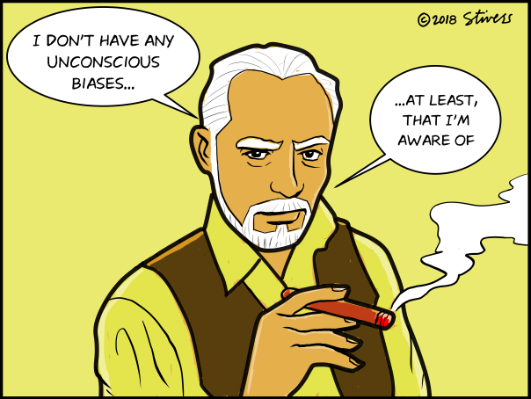
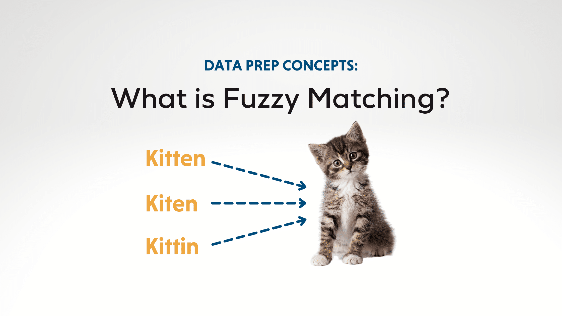
AML/WLM – Key Data Issues
Ethics
It is good for society as a whole to prevent FIs from facilitating ‘immoral’ business transactions, and to punish those institutions that deliberately, or carelessly, allow such practice^{[4]}.
Name matching is not always an exact science (see prior example). However, companies must constantly ensure that ‘Fuzzy’ matching algorithms^{[5]} minimise both false positive and false negative matches^{[6]}. (Respect those who are justly innocent, do not fail to capture the guilty).
Many FIs also use internal Watch Lists. Domestic legislation usually demands that these lists must be shown to be free of any local bias. (The term ‘Black List’ is occasionally used by FIs but for social and ethical reasons there is strong push to remove this type of language from business discourse).
This report focuses on the processing of Watch List data. The ethical and moral issues around the processes of being added or removed from such lists is only briefly considered.
Notes:
It is good for society as a whole to prevent FIs from facilitating ‘immoral’ business transactions, and to punish those institutions that deliberately, or carelessly, allow such practice.
Name matching is not always an exact science (see prior example). However, companies must constantly ensure that ‘Fuzzy’ matching algorithms minimise both false positive and false negative matches. (Respect those who are justly innocent, do not fail to capture the guilty).
FIs must implement decisions based on external Watch Lists despite not being the arbiters of who/why an individual is added. Nation states or organisations can add entries based solely on ‘suspicion’ or add PEP entries based on changes in regional politics.
Many FIs also use internal Watch Lists. Domestic legislation usually demands that these lists must be shown to be free of any local bias. (The term ‘Black List’ is occasionally used by FIs but for social and ethical reasons there is strong push to remove this type of language from business discourse).
After bottom fade in;
It goes without saying that individuals rarely ask to added to a Watch List, or give their consent.
Some may be unaware of their presence on a Watch List and legislation such as GDPR or the Irish Data Protection Act 2018 give very limited options to uncover inclusion on an EU Watch List, let alone provide an option to be removed.

Slide 7



AML/WLM – Key Data Issues
Data Governance
WLM systems developers and controllers/processors must ensure (from the C-level downwards) that established, continuous, and evolving policies are in place to keep Watch Lists up-to-date (and purged when obsolete) ^{[7]}.
WLM systems must be managed so that new Watch Lists (or deltas to existing Watch Lists) are acquired and deployed into a live production environment as soon as possible.
Every FI must have named staff that can interpret and report on why WLM software/systems flagged an individual or transaction against a given Watch List^{[7]}.
Notes:
WLM systems developers and controllers/processors must ensure (from the C-level downwards) that established, continuous, and evolving policies are in place to keep Watch Lists up-to-date.
FI management must be able to show that redundant, or obsolete, copies have been be deleted/destroyed.
WLM systems must be managed so that new Watch Lists (or deltas to existing Watch Lists) are acquired and deployed into a live production environment as soon as possible.
Every FI must have named staff that can interpret why internal (or vendor) WLM software flagged an individual or transaction against a given WatchList.
A named individual, or group of individuals, within an FI must hold responsibility for the reporting of suspicion activity to the relevant regulatory authority. This group must also be aware of the penalty for the FI for failure, by inaction or inability, to comply with these regulations.

Slide 8



AML/WLM – Key Data Issues
Data Privacy
Access to Watch Lists must be restricted to those with appropriate clearance^{[8]}. This data restriction is a challenge for software vendors of WLM systems. In the development process ‘real’ data is often a key ingredient in building effective name matching algorithms and alert scoring processes.
Watch List data must not be used outside of the intended purpose of preventing money laundering or the funding of illegal activity (a Use Limitation Principle applies). For example, EU GDPR prevents such data being used for internal customer ‘profiling’^{[9]}.
Example: GDPR Article 17 contains legislation on the ‘right to be forgotten’. However, the EU’s 4/5AMLDw take precedence and an FI must record history of suspected suspicious activity for five years^{[9]}. Also, GDPR allows data to be preserved to comply with a ‘legal ruling’, which make it difficult for an individual to be removed from an EU based Watch List.
Notes:
Access to Watch Lists must be restricted to those with appropriate clearance. This data restriction is a challenge for software vendors of WLM systems. In the development process ‘real’ data is often a key ingredient in building effective name matching algorithms and alert scoring processes.
Watch List data must not be used outside of the intended purpose of preventing money laundering or the funding of illegal activity (a Use Limitation Principle applies). For example, it cannot be used for internal customer ‘profiling’.
GDPR Article 17 contains legislation on the ‘right to be forgotten’. However, the EU’s 4AMLD takes precedence and an FI must record history of suspected suspicious activity for five years. Also, GDPR allows data to be preserved to comply with a ‘legal ruling’, which make it difficult for an individual to be removed from an EU based Watch List.

Slide 9



Selecting a Vendor in the AML/WLM Domain

Slide 10

BAE Digital Intelligence NetReveal
The BAE Systems D.I. NetReveal (NR) AML/WLM solution is one of the key vendor offering in this Compliance space for FIs. (https://www.baesystems.com/en-financialservices/solutions/banking-compliance)
Market presence is significant in the EMEA and Asia Pacific regions.
NR name screening processes face all the key challenges associated with modern AML/WLM systems.
It is important to note that NR AML/WLM solutions, in common with most similar vendor solutions, do not limit name matching to just ‘names’. Other identifiers can, and must, be used in the matching process, for example DOB, country of birth, names of known associates, etc.

Slide 11
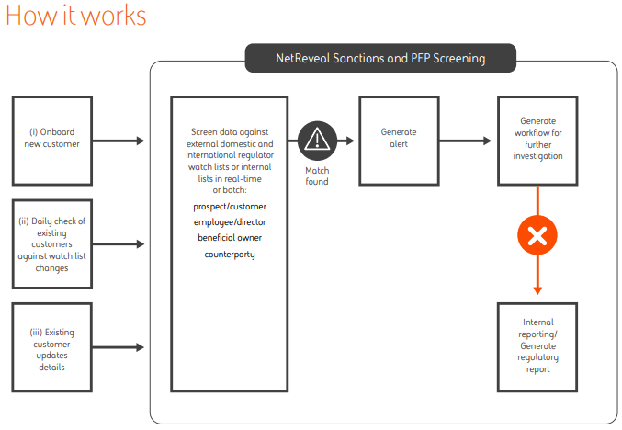

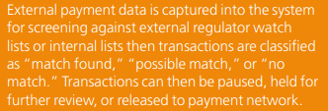
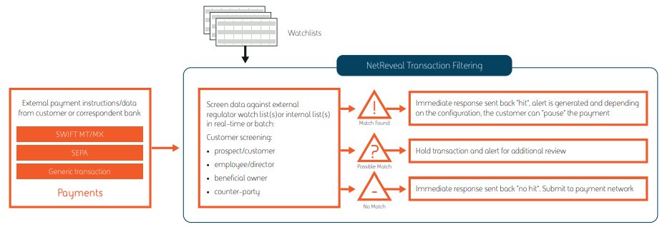
BAE Digital Intelligence NetReveal
^{[10]}
^{[11]}

Slide 12
BAE Digital Intelligence NetReveal
Data Governance
The NetReveal solution is deployed ‘on premise’, usually in parallel with consultancy services on how best to deploy the solution. Client data is never transferred to an off-site hosted solution.
The product supports automated interfaces to all major Watch List portals, such as Dow Jones, Acuity, BOE, etc.
WLM algorithms ‘score’ each matched name and generate an alert, with explanation, based on a predefined score threshold.
Suspicion Activity Reports (SARs) are generated by the NR solution in the format required for a given jurisdiction. For example, the FinCEN e-file system in the United States.
The NR systems, and deployment consultant and support engineers, act as a processor of Watch List data but do not control the end result of the name matching process.
Notes:
Article 28 of GDPR states that data controllers must appoint data processors, like BAE Systems, who can offer and demonstrate “sufficient guarantees” of GDPR compliance – in the area of AML in this case.
Since the NR system processes personal data for each clients for AML purposes, the GDPR compliance guarantees must be set out in the terms of service agreements.

Slide 13
BAE Digital Intelligence NetReveal
Data Privacy
In the NR Solution, user profiles are configured on site (within the FI infrastructure) to specifically identify ‘Data Stewards’ for Watch List and client transaction data. System profiles are tailored to isolate appropriate privileges for these roles.
GDPR legislation requires that access to PII is restricted to only those with a legitimate need to process the data. It is the subject of current debate that this may exclude software engineers and testers who develop NR WLM software. This is an EU industry wide challenge, for which a definitive ruling has not yet been made.
In line with GDPR recommendations, NR WLM algorithms do not include ethnicity, sexual orientation, or religion in the name matching process. However, GDPR critics have complained that applications like NR make it relatively easy to infer such PII data from their WLM processes.

Slide 14
BAE Digital Intelligence NetReveal
Data Ethics
Every new NR product release delivers refinements to name matching algorithms to reduce false positive and false negative results.
A false positive result generates unnecessary, and expensive, workloads for company investigators and may unfairly deliver poor service to a customer.
The much greater ethical concern is a false negative that fails to capture restricted activity for which the FI is legally, and morally, bound to intercept.
Expanding NR deployments into new territories requires new product investment to ensure regional name matching requirements are met. For example, regulators will not accept that WLM algorithms fail to capture criminal activity because it was ‘too expensive’ to track names in Cyrillic text. The NR WLM engine has libraries to parse names with characters in Mandarin, Korean, Thai, etc.
The content of the Watch Lists, including supported internal watch lists, is the responsibility of the provider – not the vendor (NR in this case). However, GDPR does allow a FI to configure the NR system to make automatic decisions based on a Watch List match.

Slide 15

BAE Digital Intelligence NetReveal
Good Practice
Name matching technologies within NR are becoming increasingly sophisticated. New product innovations include the deployment of ML techniques to refine WLM scores.
More accurate name matching prevents misuse, accidental or otherwise, of personal data held within Watch Lists.

Slide 16

BAE Digital Intelligence NetReveal
Concerns
Criminals using FI services continue to be increasingly sophisticated at masking their identity, including those seeking to dodge international sanctions.
NR WLM solutions are under constant pressure to evolve to prevent money laundering or funding activities that are contrary to the common good of society.

Slide 17
References
[1] Research Staff, C. (2019). Financial Crime Risk Management Systems: AML and Watchlist Monitoring: Market Update and Vendor Landscape 2019 - Chartis Research. Retrieved 22 February 2022, from https://www.chartis-research.com/financial-crime/anti-money-laundering-aml/financial-crime-risk-management-systems-aml-and-watchlist-monitoring-2019-10741
[2] Rogan, A. (2018). Micheál Mac Donncha, Dublin lord mayor banned by Israel, slips in after name mix-up at border. Retrieved 26 February 2022, from https://www.thetimes.co.uk/article/miche-l-mac-donncha-banned-by-israel-slips-in-after-name-mix-up-at-border-rwlpkk5lp
[3] Frasher, M. (2021). Data protection and the EU's anti-money laundering regulation. Retrieved 23 February 2022, from https://iapp.org/news/a/data-protection-and-the-eus-anti-money-laundering-regulation/
[4] Armitage, H., & Blood, C. (2021). What should data ethics mean to Financial Service providers. Retrieved 23 February 2022, from https://www.baesystems.com/en-financialservices/insights/blog/what-should-data-ethics-mean-to-financial-service-providers
[5] Nino, R., Medina, R., & Sison, A. (2019). Development of Fuzzy Risk Score Assessment Framework for Sanctions Screening. International Journal Of Engineering Research And Technology, 12(4), pp. 554-562. Retrieved from http://www.ripublication.com/irph/ijert19/ijertv12n4_15.pdf
[6] Del Mundo, C. (2019). How Countries Seek to Strengthen Anti-Money Laundering Laws in Response to the Panama Papers, and the Ethical Implications of Incentivizing Whistleblowers. Northwestern Journal Of International Law & Business, 40(1 Fall), 112 - 114. Retrieved from https://scholarlycommons.law.northwestern.edu/njilb/vol40/iss1/3/

Slide 18
References
[7] Central Bank of Ireland. (2021). Anti-Money Laundering and Countering the Financing of Terrorism Guidelines for the Financial Sector (pp. pp 55-65). Dublin: Central Bank of Ireland. Retrieved from https://www.centralbank.ie/docs/default-source/regulation/amld-/guidance/anti-money-laundering-and-countering-the-financing-of-terrorism-guidelines-for-the-financial-sector.pdf?sfvrsn=9
[8] Art. 5 GDPR - Principles relating to processing of personal data - GDPR.eu. (2020). Retrieved 28 February 2022, from https://gdpr.eu/article-5-how-to-process-personal-data/
[9] Managing AML Challenges Under GDPR. (2021). Retrieved 23 February 2022, from https://complyadvantage.com/insights/anti-money-laundering/gdpr-aml/
[10] Transform your Sanctions and PEP Screening processes. (2021). Retrieved 26 February 2022, from https://www.baesystems.com/en-financialservices/solutions/banking-compliance/sanctions-and-pep-screening
[11] Transform your transaction filtering processes. (2021). Retrieved 26 February 2022, from https://www.baesystems.com/en-financialservices/solutions/banking-compliance/transaction-filtering

